Slide 1
Practical#05
Designing deployment and package diagrams
Dr. Rabeea Jaffari

Slide 2
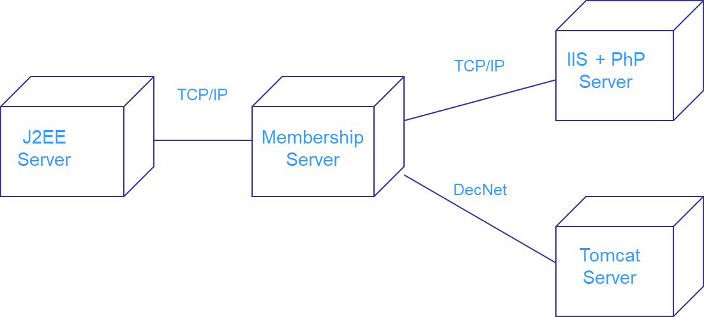
Deployment Diagram
Shows the physical architecture of a computer-based system.
It can depict the computers and devices (nodes), show their connections with one another, and show the software (artifact) is deployed on the nodes.
Nodes typically enclose one or more components.
Represents the static deployment view of an architecture.

Slide 3
Deployment Diagram
Two types of Nodes:
Device Node
Environment Execution Node (EEN)
Device Node: Physical computing resources; the hardware. With processing memory and services to execute the software. E.g: PC, Laptop, Mobile Phone etc.
EEN: A software computing resource that runs within an outer node. Provides services to host and execute other executable software elements. E.g: OS, JVM, Servlet Container etc.

Slide 4
Purpose
Visualize hardware topology of the system.
Describe the hardware components used to deploy the software components.
Describe the runtime processing nodes.
Forward and reverse engineering.

Slide 5

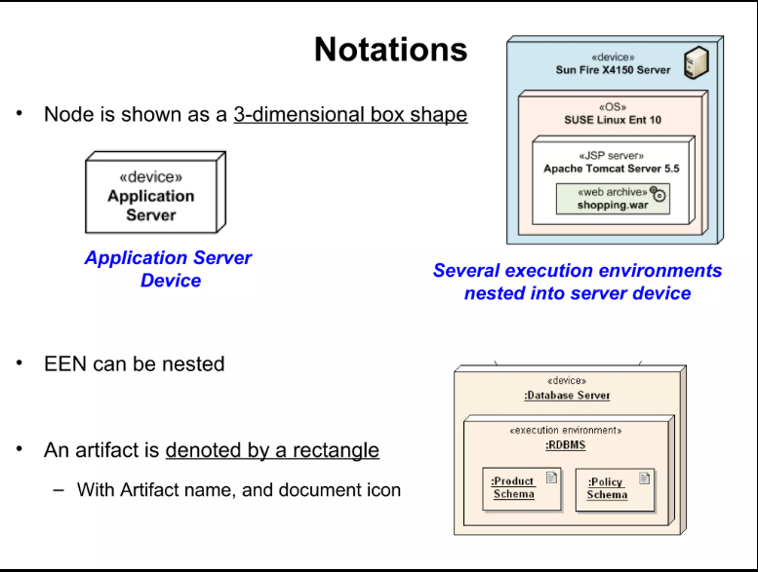
Basic Deployment Diagram Symbols and Notations

Slide 6
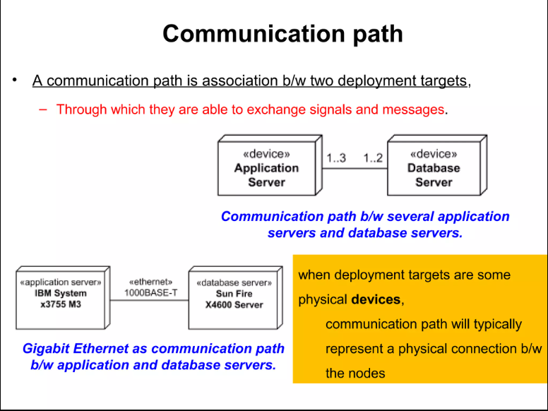
Basic Deployment Diagram Symbols and Notations

Slide 7
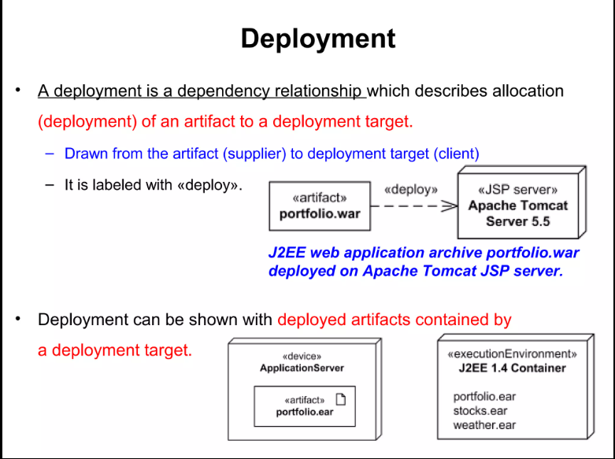
Basic Deployment Diagram Symbols and Notations

Slide 8
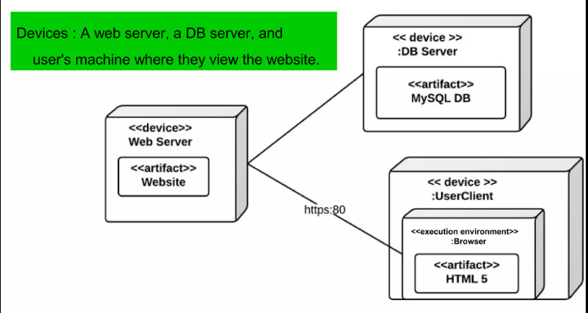
Deployment Diagram Example

Slide 9
Package Diagram
Shows packages of classes and the dependencies between them.
Package: A UML construct that enables us to organize model elements, such as classes, into groups.
More abstract than the class diagram.
Usually classified as a structural UML diagram.

Slide 10
Purpose
Depict high-level view of your architecture/design.
Depict high-level overview of your requirements.
Logically modularize a complex diagram.
Organize programming source code.
Usually used for very large applications.

Slide 11
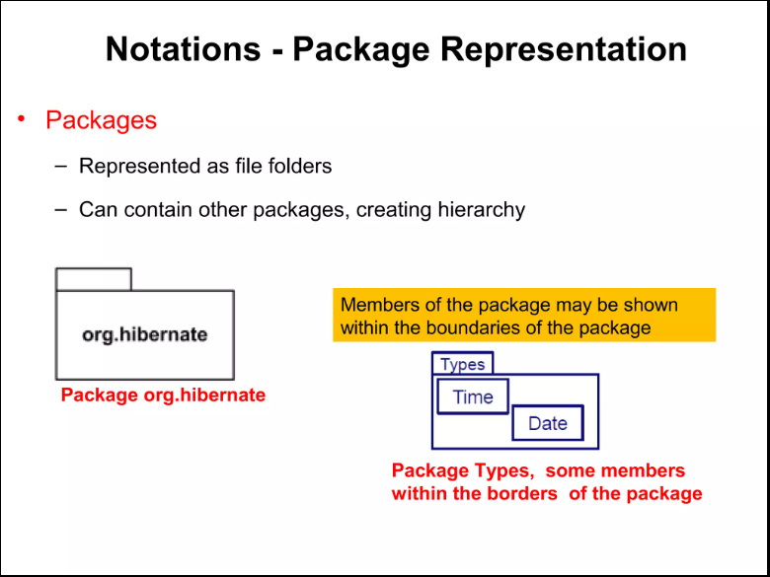
Basic Package Diagram Symbols and Notations

Slide 12
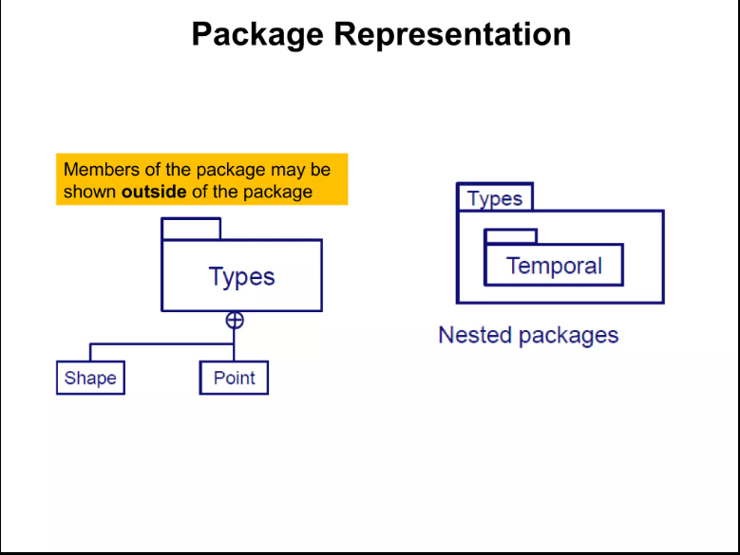
Basic Package Diagram Symbols and Notations

Slide 13
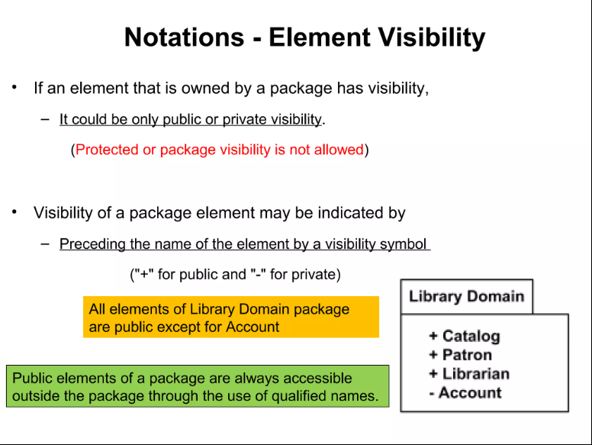
Basic Package Diagram Symbols and Notations

Slide 14
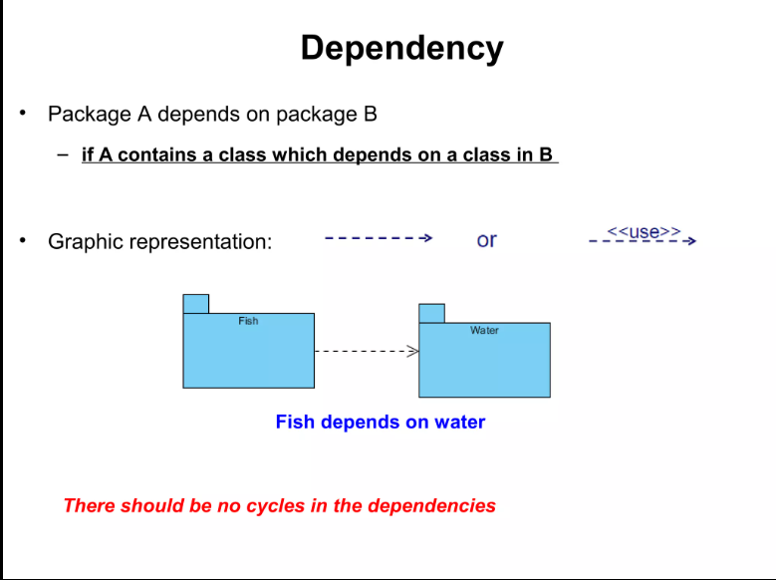
Package Diagram Relations
Dependency
Implementation
Import/ Access
Merge

Slide 15
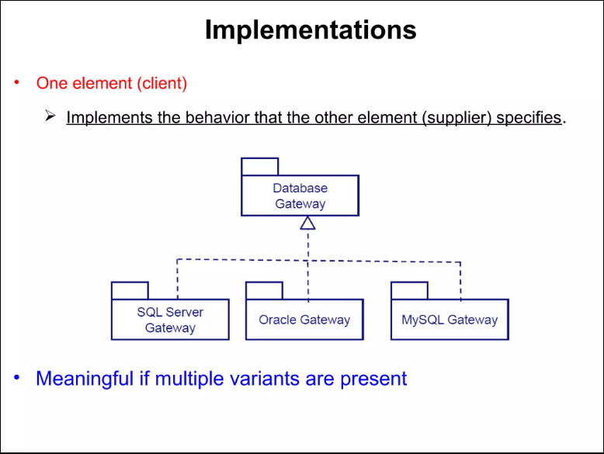
Package Diagram Relations
Dependency
Implementation
Import/ Access
Merge

Slide 16
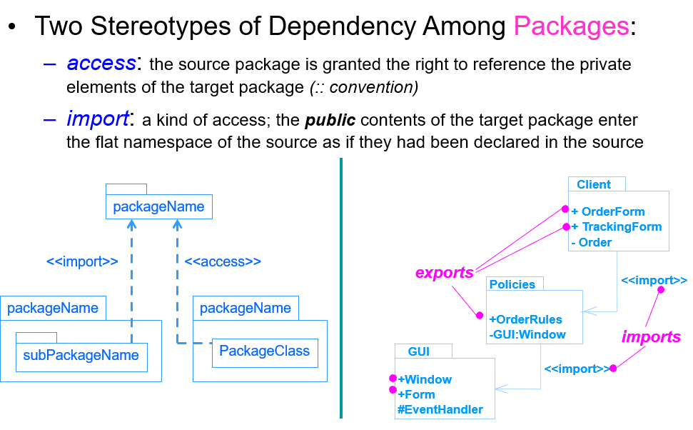
Package Diagram Relations
Dependency
Implementation
Import/ Access
Merge

Slide 17
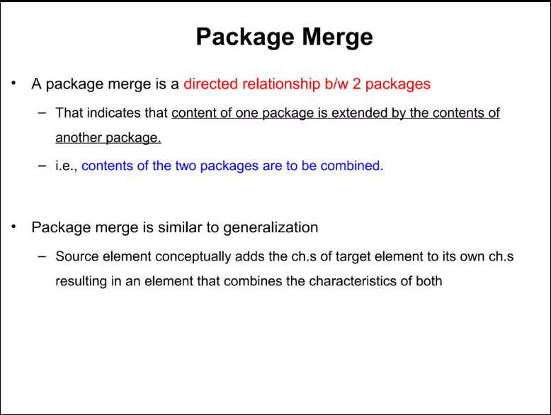
Package Diagram Relations
Dependency
Implementation
Import/ Access
Merge

Slide 18
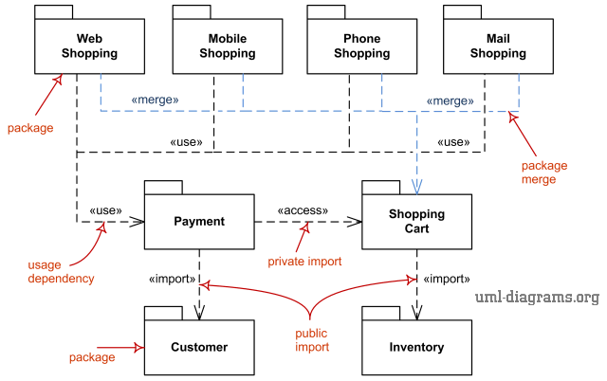
Package Diagram Example

Slide 19
TASK:
Create package and deployment diagrams for any system of your choice.

